Slide 1


Predicting EV Charging in Apartment Buildings

Slide 2

Introduction
In a world moving towards sustainability, as traditional fuel resources depleting and environmental worries grow, there is a notable shift towards electric solutions. More individuals are opting for electric vehicles (EVs), and countries are actively planning to fully embrace the reliance on EVs for a more sustainable future.
02 FEBRUARY 2024
ZHASSULAN YESHMUKHAMETOV

Slide 3

Problem Statement
Challenges of energy consumption and load prediction in the context of residential electric vehicle (EV) charging in apartment buildings

Slide 4

Dataset
Residential EV Charging Data
What does the Data look like:
Dataset 1: EV charging reports
Dataset 2: Hourly EV charging loads and idle capacity, for all sessions and users individually
Dataset 3 and 4: Hourly EV charging loads and idle capacity, aggregated for private or shared CPs
Dataset 5: Hourly smart meter data from garage Bl2
Dataset 6: Local traffic density
Dataset 7: Weather Data

Slide 5
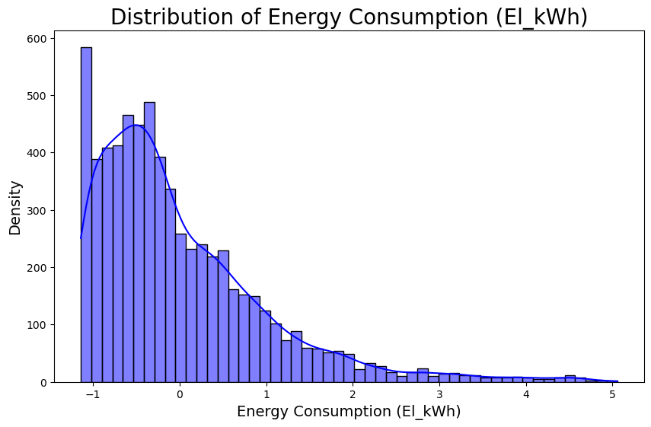
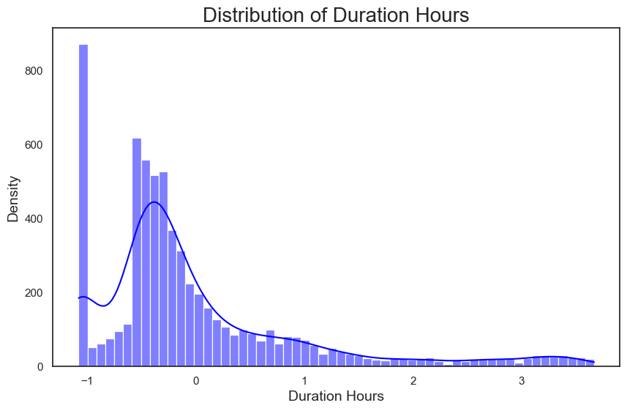
EDA
Target Variable
Independant Feature
The amount of electrical energy consumed, measured in kilowatt-hours (kWh)
Is the amount of time that a vehicle is connected to a charging station to replenish its battery

Slide 6
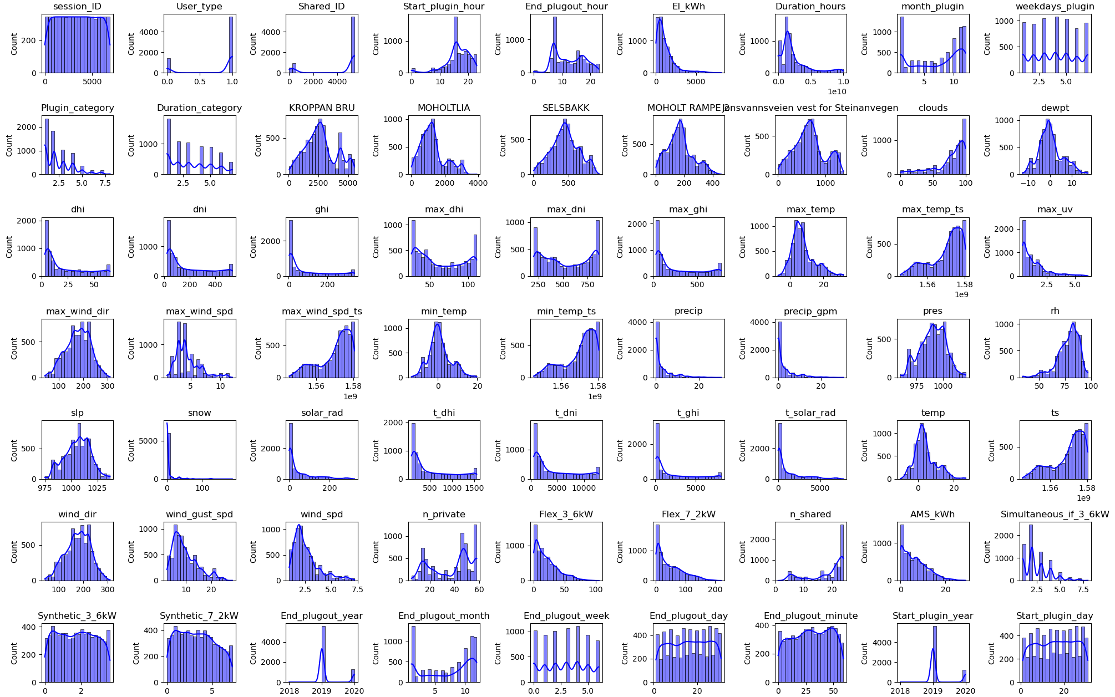

Slide 7

Feature Engineering
Techniques
Date and Time Features:
Hour/day/week/month/year
Feature Scaling:
Standardization or normalization of numerical features
Outlier Handling:
Identification and handling of outliers
Missing Data Handling:
Imputation or removal of missing data
Encoding Categorical Variables
Utilized one-hot encoding

Slide 8



Baseline Models
Random Forest Regressor
Linear Regression
Gradient Boosting Regression

Slide 9
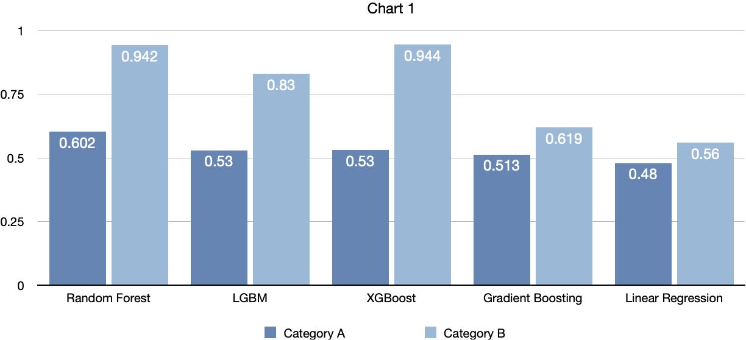
Baseline Models Comparison
Results
Random Forest has both the highest R-squared (R2) score on validation and train set , it strengthens the evidence in favor of its performance.
Results interpretation
Non-Linear Patterns:
High Feature Correlation:
Multicollinearity Mitigation:
Robust Against Outliers:

Slide 10
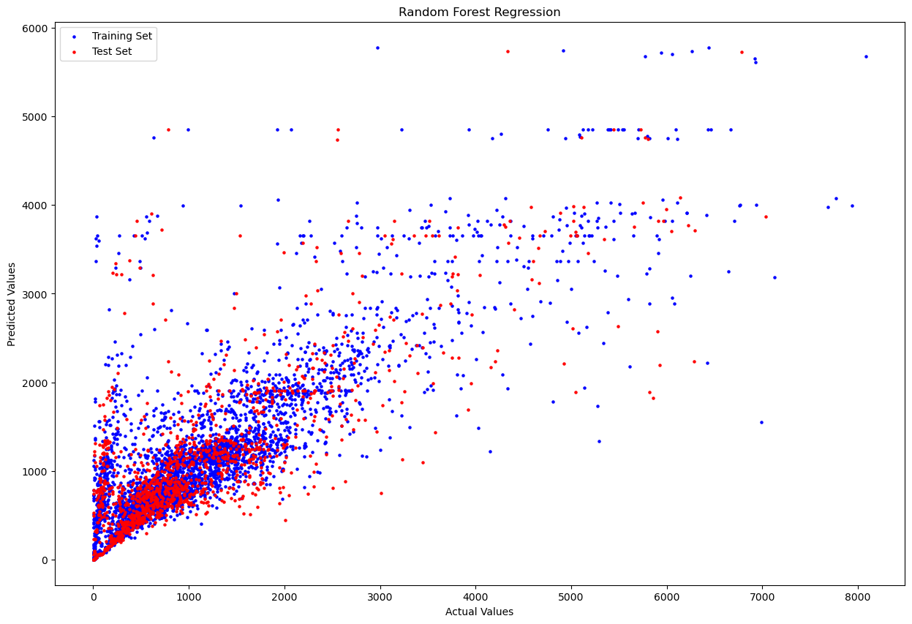
Random Forest Regression Model Results
The scatter plot visually examines the model's predictions on the test and validation sets. The proximity of points to the diagonal line reflects the alignment of predictions with the actual values. R-squared (R2) scores of 0.61 for the Test set and 0.70 for the Train set indicate a reasonably strong fit, capturing a substantial portion of the variance in both datasets.
Conclusion:
The outcomes from the random forest regression model suggest that approximately 56-57% of the features effectively predict energy consumption.

Slide 11
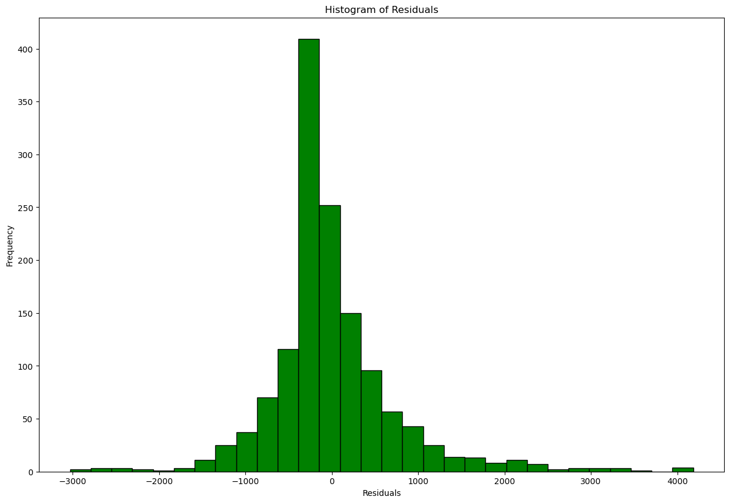
Residuals
Observation:
The residuals are spread relatively evenly across the range of predicted values, it suggests homoscedasticity.
The errors are normally distributed.
The residuals that are centered around zero represent a well-fitted model.
Outliers in the residuals may indicate data points that the model is not capturing well. Will need to be investigated.

Slide 12



Conclusion
Firstly, at a societal level, optimizing energy consumption in residential EV charging can contribute to overall energy efficiency and sustainability.
From a business standpoint, property managers and energy providers can gain from implementing efficient energy management, leading to reduced costs, optimized infrastructure investments, and an improved charging experience for EV users.

Slide 13
Next Step:
Go back to EDA
Feature Engineering
Model Evaluation and Fine-Tuning
Deeplearning models
Reinforcement learning to optimize energy consumption

Slide 14
A quote
“If you torture the data long enough, it will confess to anything”
Ronald Coase

